Slide 1

Web Automation Using SELENIUM
By-
Samarvir Singh
AQE

Slide 2
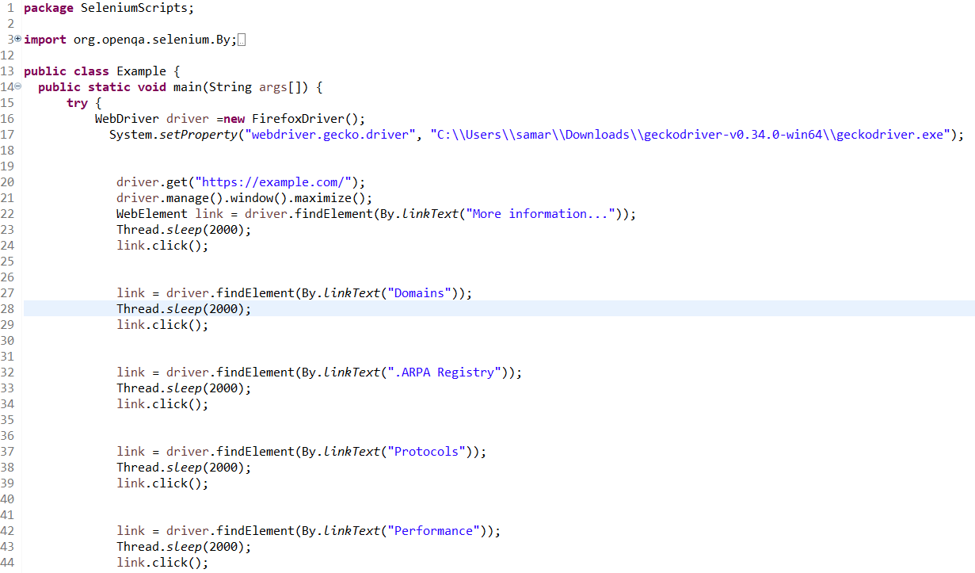
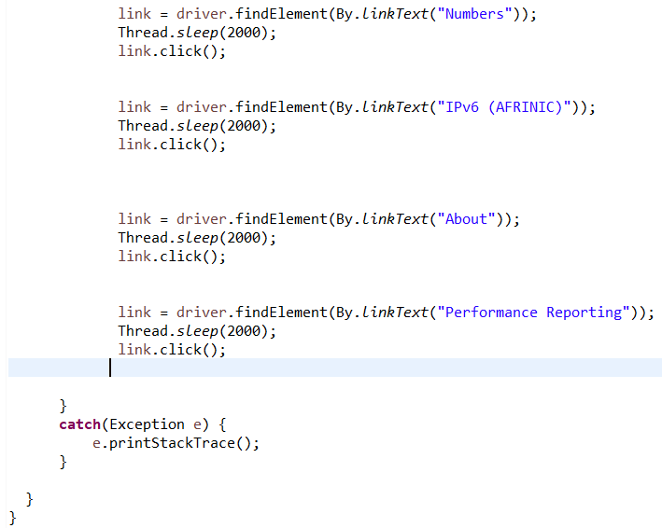
Example Website(https://example.com/)

Slide 3
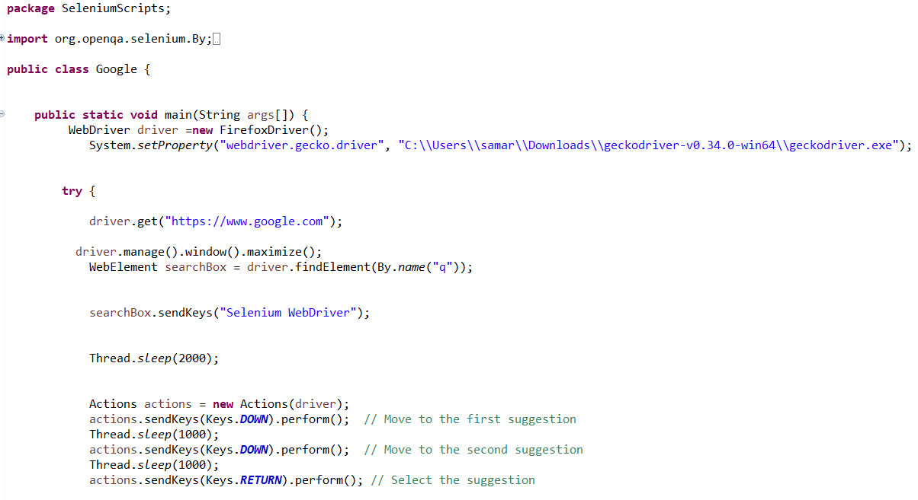
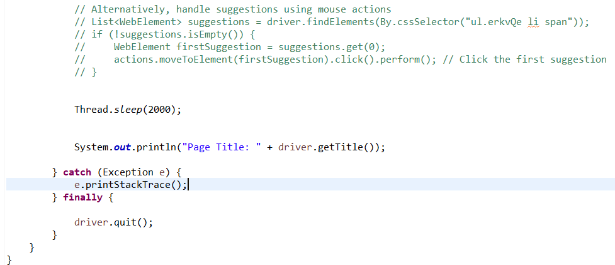
Keyboard,Mouse Events(Google.com)

Slide 4
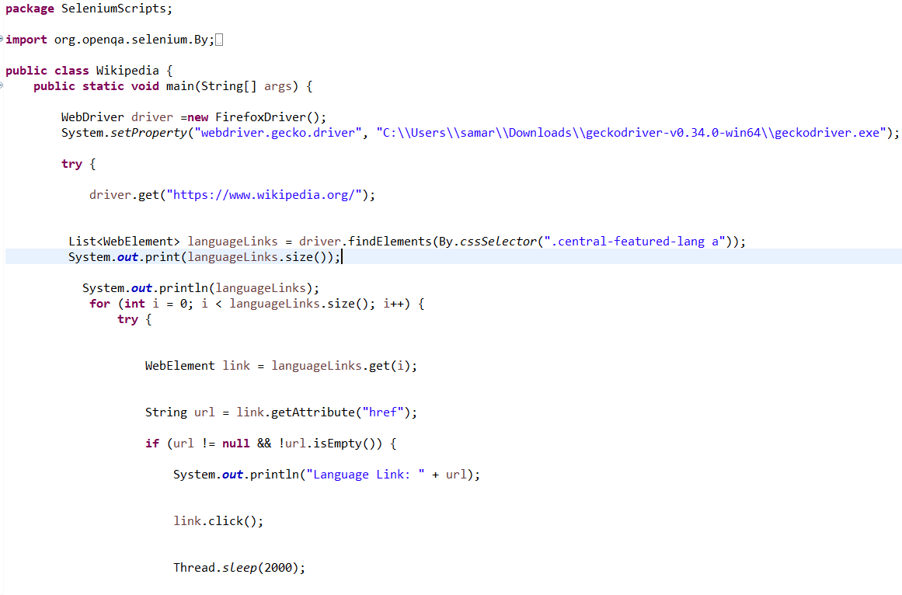
Wikipedia

Slide 5
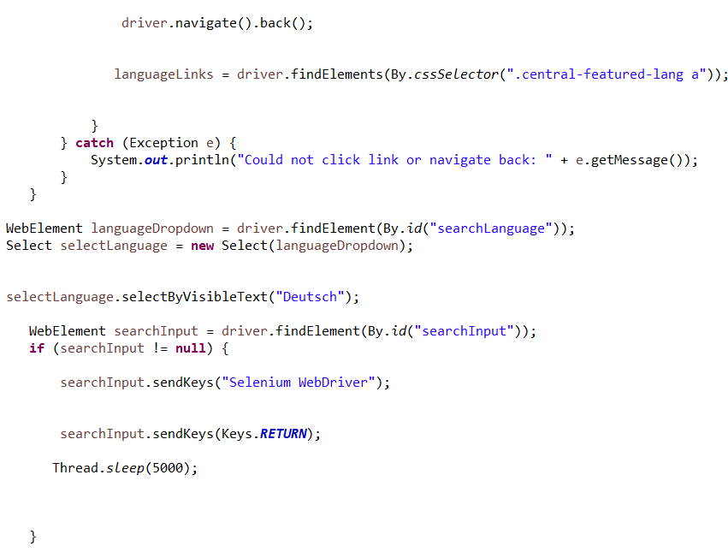
Wikipedia (Cont)

Slide 6
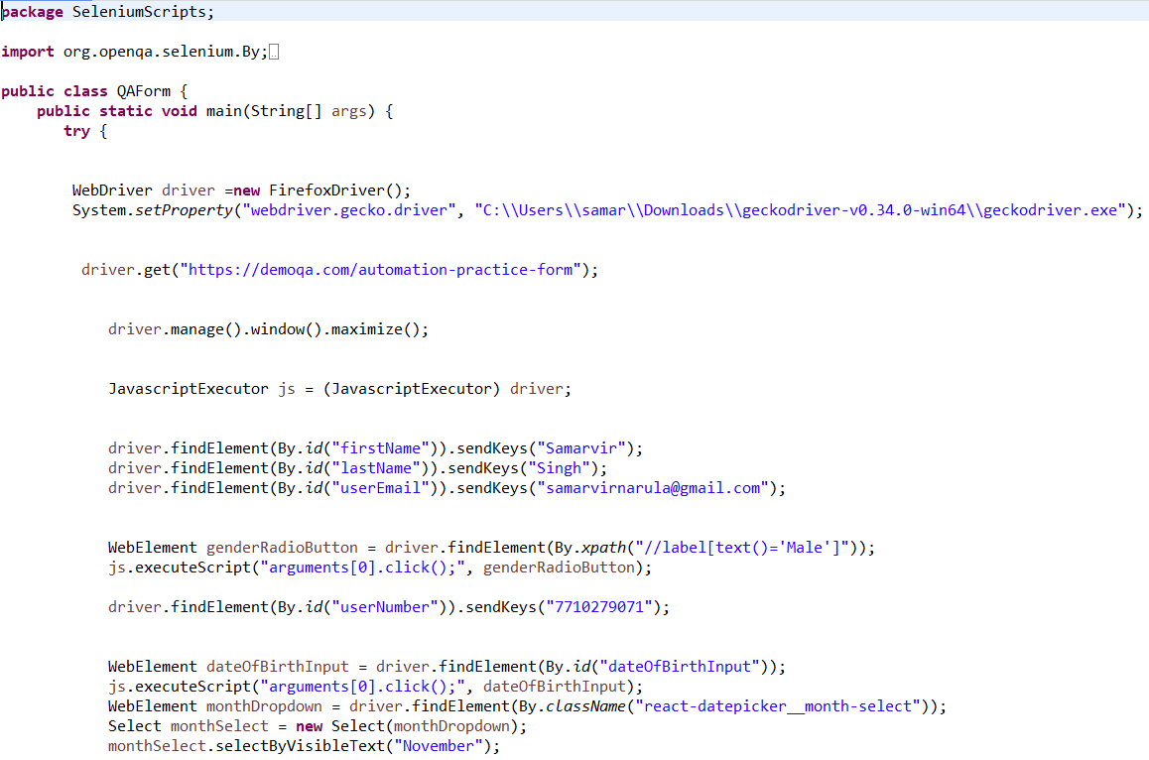
DemoQA

Slide 7
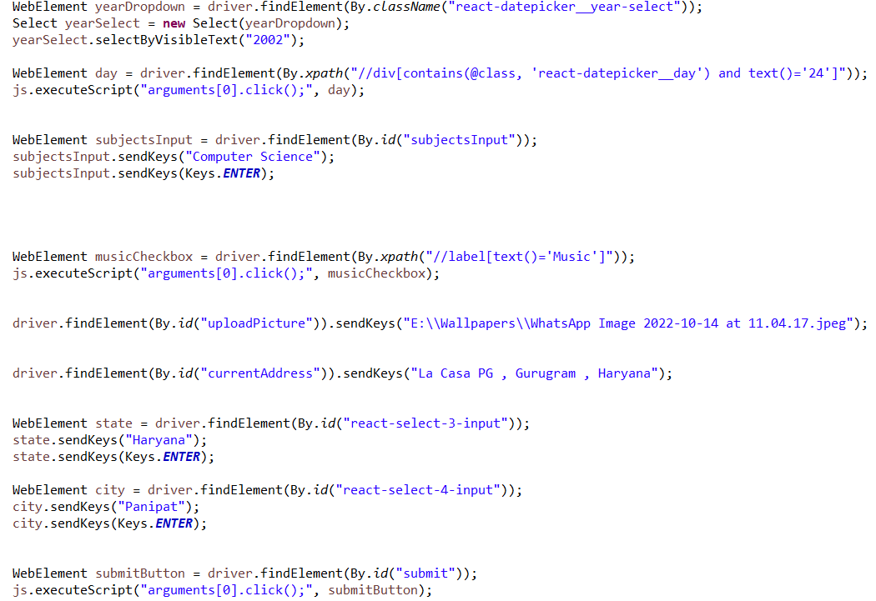
DemoQA(Cont)

Slide 8
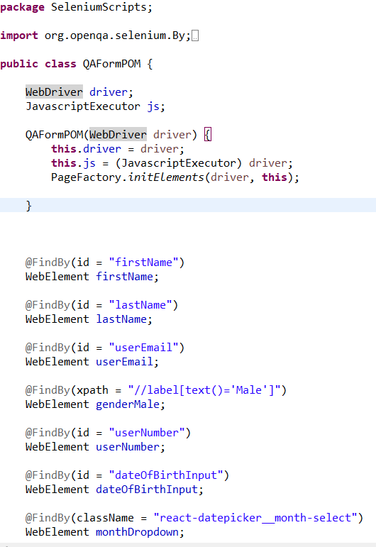
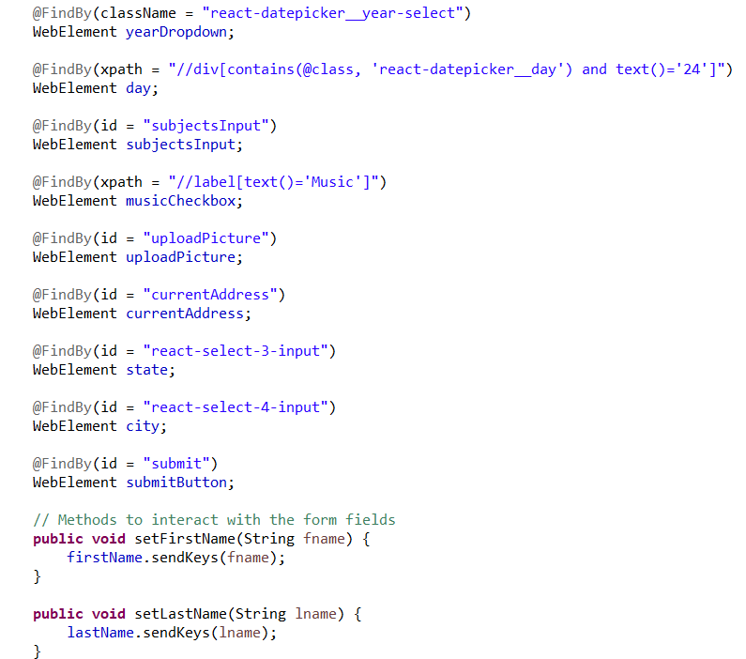
DemoQA with POM

Slide 9
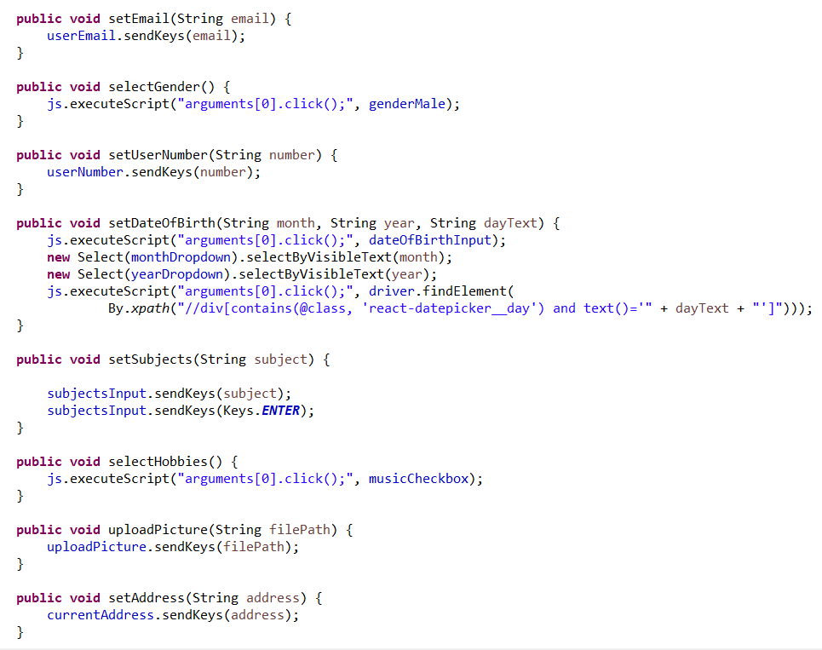
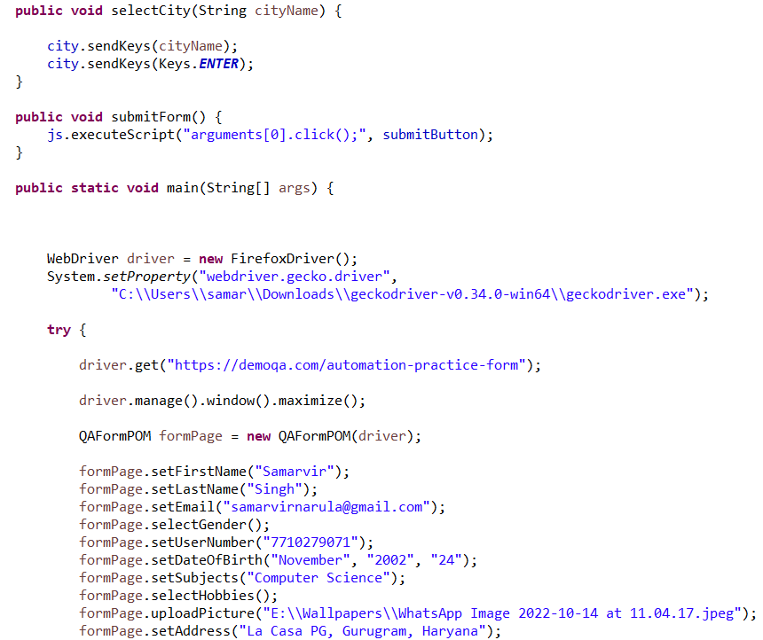
DemoQA with POM (Cont)

Slide 10
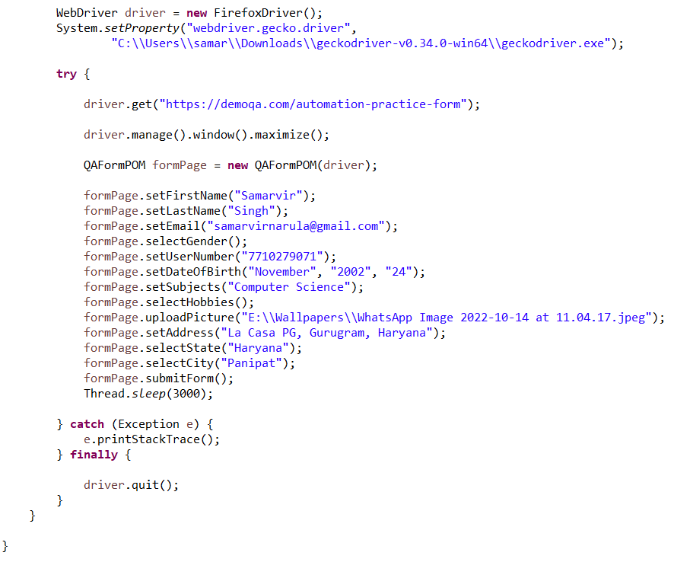
DemoQA with POM (Cont)

